Slide 1

Logic Gates
IGCSE Computer Science
Hardware and Software unit

Slide 2

Topic Overview
Logic gates
Truth tables
Logic circuits
Logic statements

Slide 3
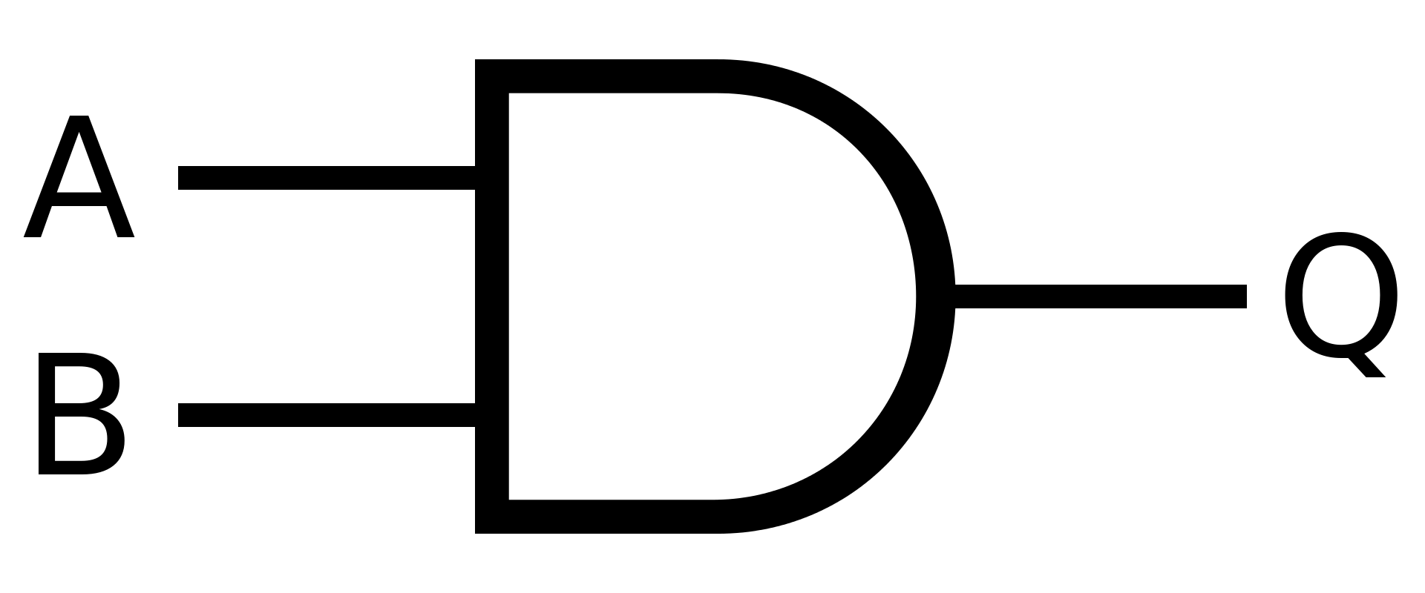

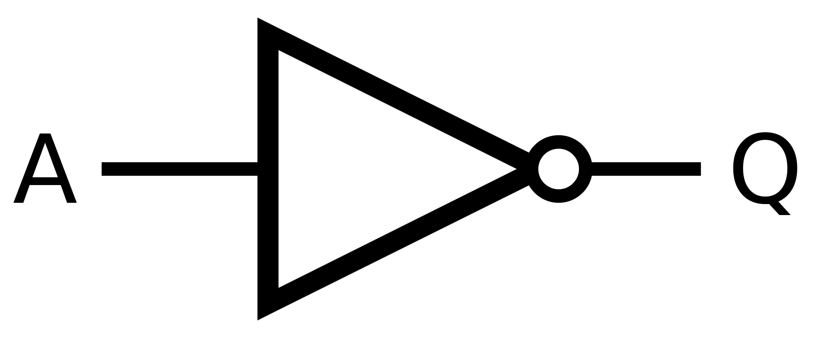
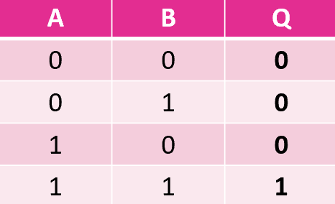
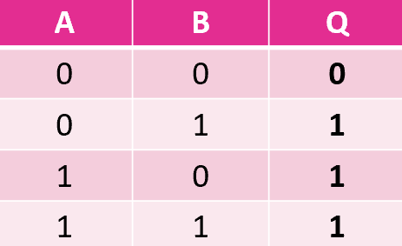
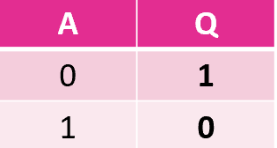
3 Basic Gates & Truth Tables
AND | OR | NOT

Slide 4
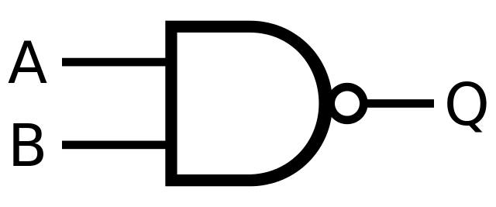
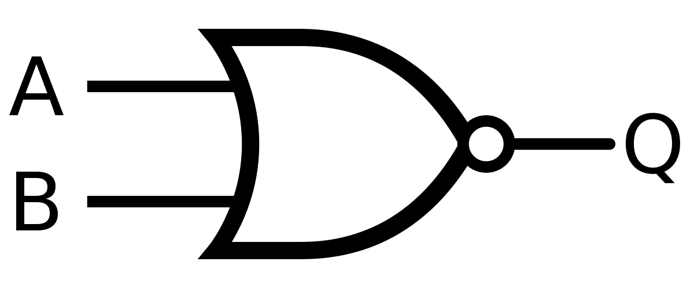
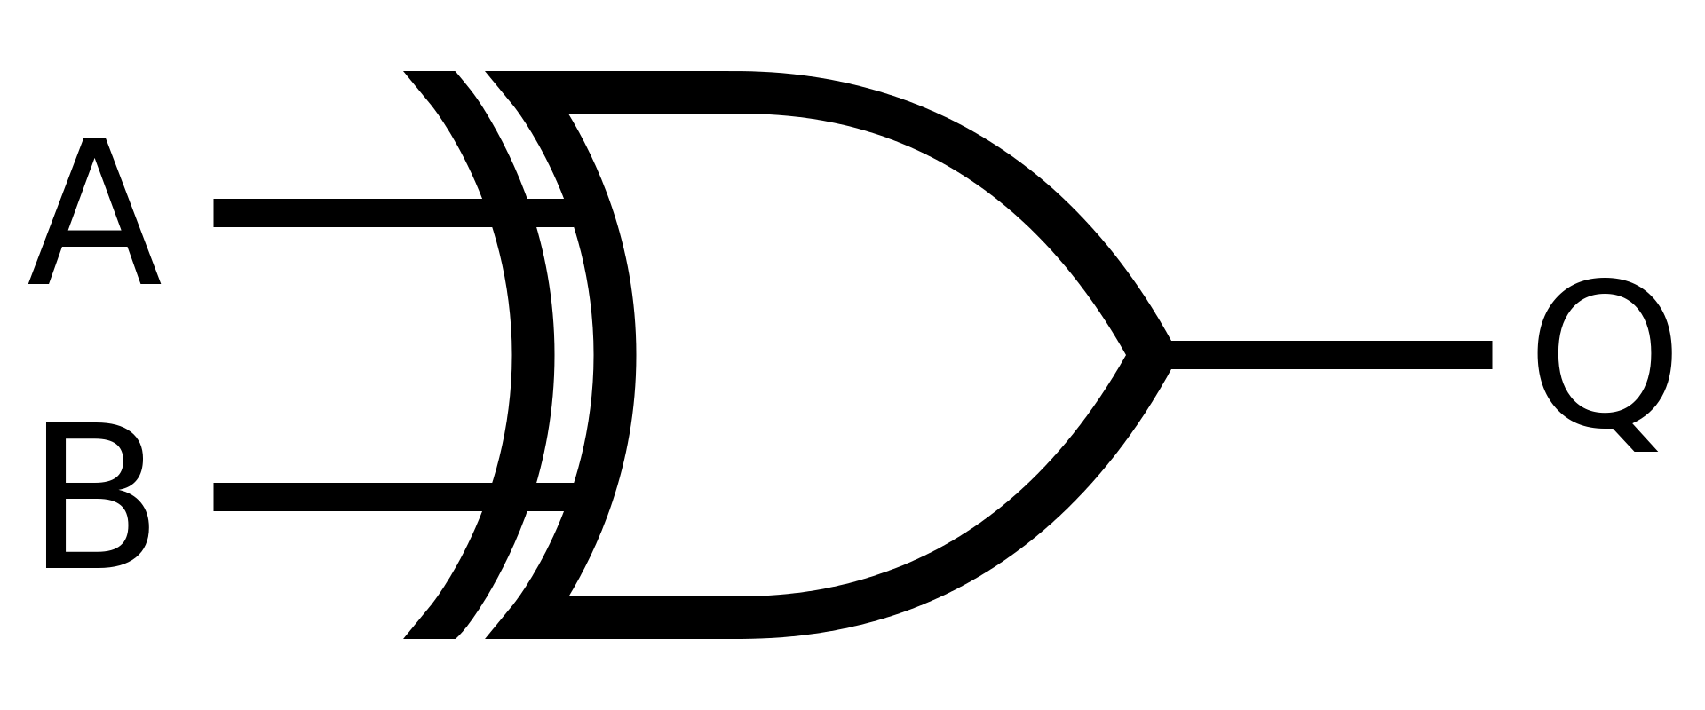
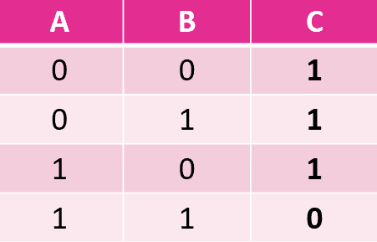
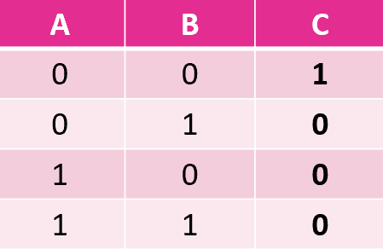
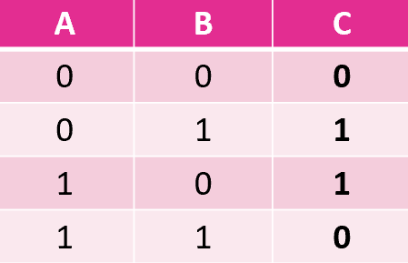
3 Extended Gates
NAND | NOR | XOR

Slide 5
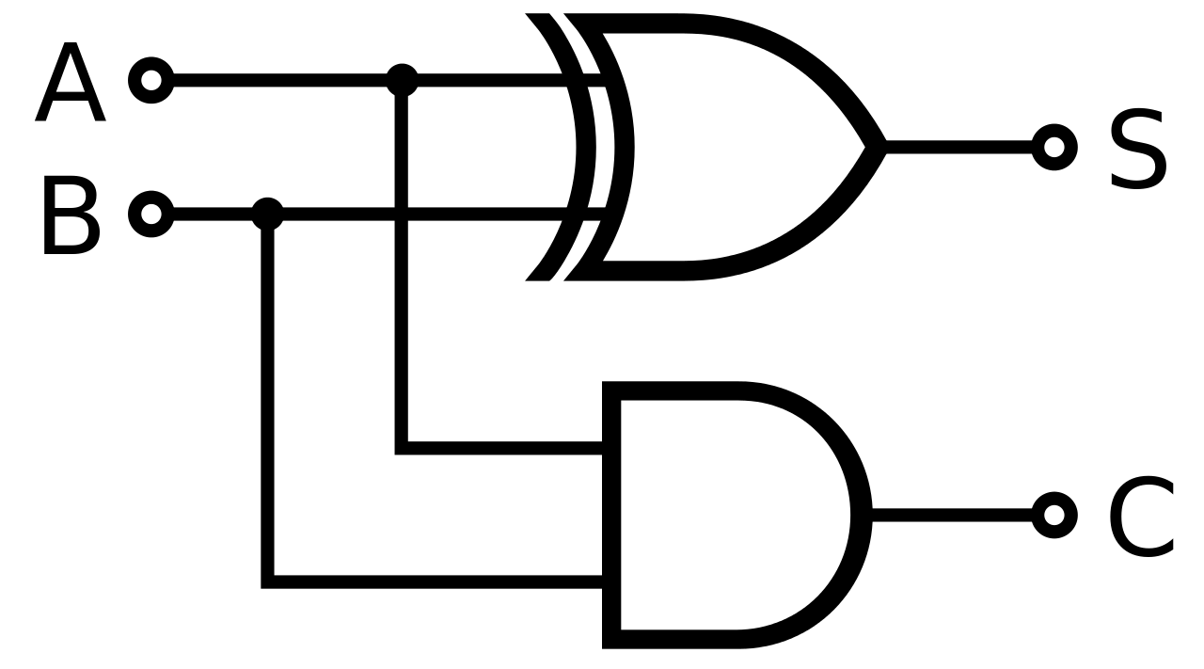
Logic Circuits
A | B | S | C
0 | 0 | 0 | 0
0 | 1 | 1 | 0
1 | 0 | 1 | 0
1 | 1 | 0 | 1
Notes:
Half-adder logic circuit

Slide 6

Logic Statements
Describe the combination of inputs that will produce a 1 as the output from a logic circuit.
The written form of a logic circuit.

Slide 7

Examples…
X = A AND B
X = A OR B
X = NOT(A) OR (A AND NOT(B))
X = NOT(A OR B)
X = A OR (NOT(B) OR C)
Notes:
Exercise: Draw logic circuits from these logic statements.

